Slide 1
An Introduction to Azure Data Factory v1
Everything you need to know to start developing today

Slide 2
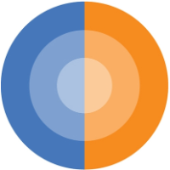

Who are these people?!
Parinaz Kallick – Business Intelligence Consultant
Working with BI for 10 years (Origins in databases and reporting &
MSBI Stack)
B.S in Computer Science
MBA-IT
Eric Bragas – Business Intelligence Consultant, MCP
Working with Microsoft BI for 5+ years
Azure and Power BI for 3+ years
California native, based in San Francisco
Eastern cuisine aficionado

Slide 3
Agenda
What is Data Factory?
How does it work?
Core Components
How to Develop
Demo
Monitoring & Management
Use Cases
Challenges Best Practices

Slide 4
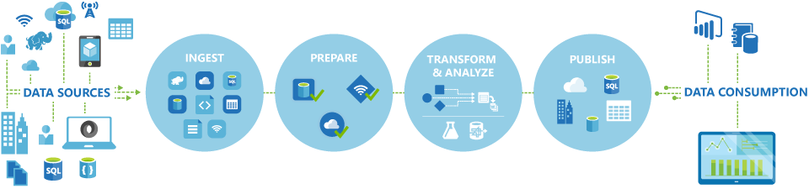
What is Azure Data Factory (ADF)?
"[Azure Data Factory] is a cloud-based data integration service that allows you to create data-driven workflows in the cloud that orchestrate and automate data movement and data transformation.“
In short - it's Azure's PaaS service for time series data integration

Slide 5
How Does it Work?
Leverages cloud resources to Extract, Load, and Transform your data
Storage - Azure Blob Storage, HDInsight, Azure SQL DW, etc.
Compute - Hive Query, Azure SQL DW, etc.
ELT over ETL
Time-series paradigm, ie. web logs, social sentiment, sensor data

Slide 6
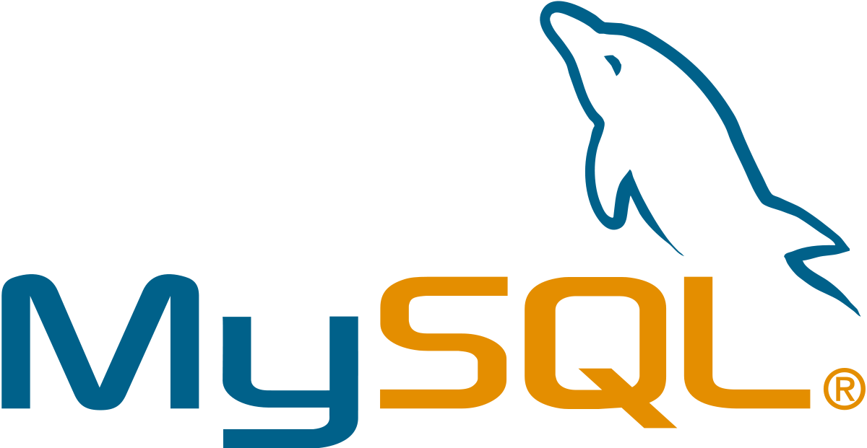
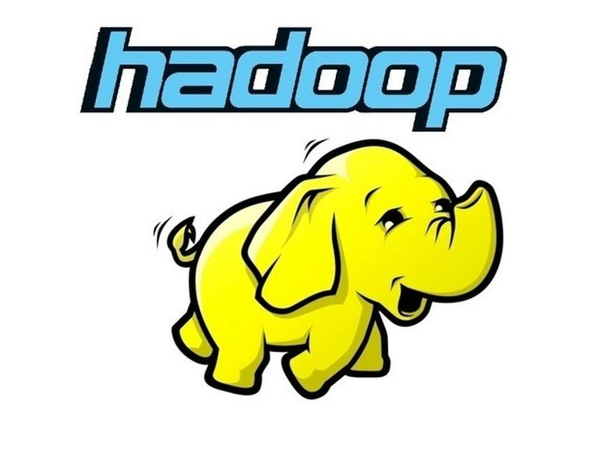

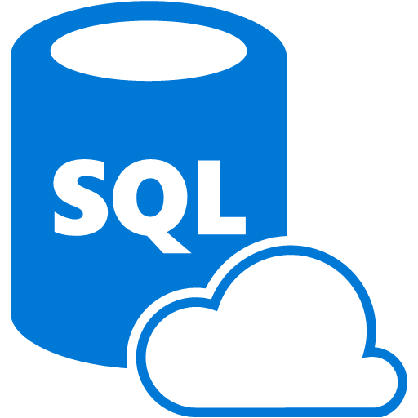

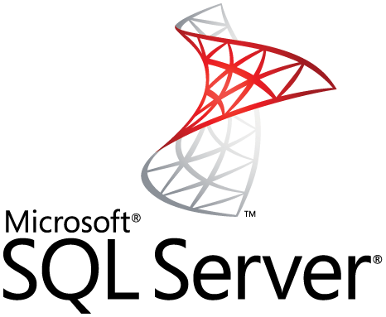

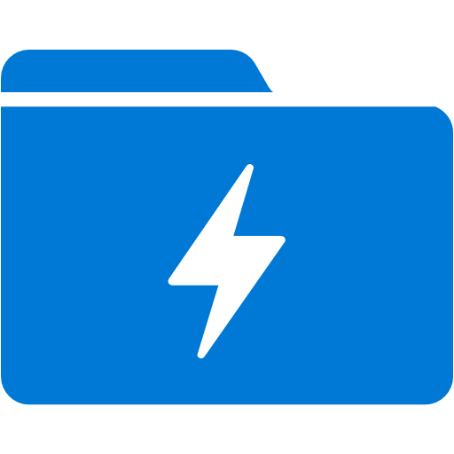
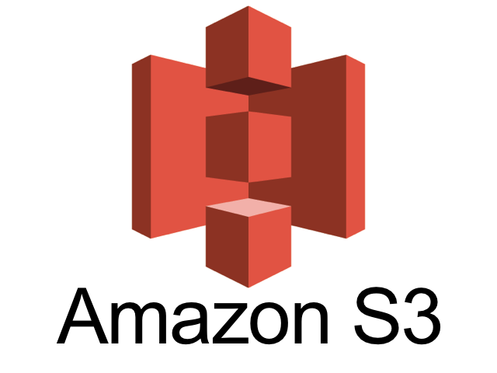
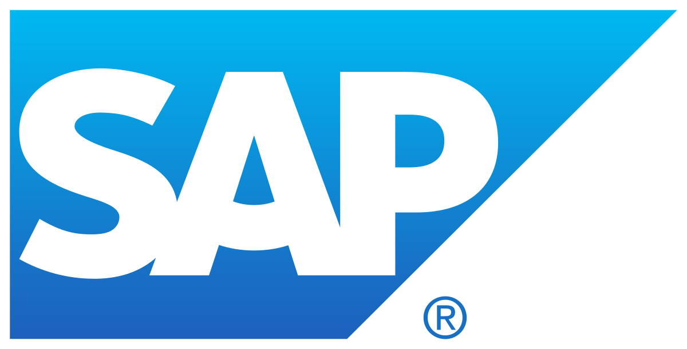
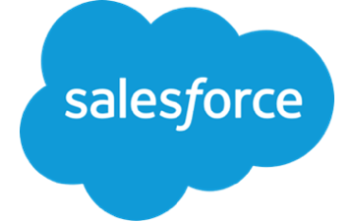
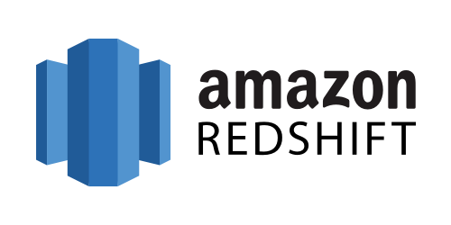
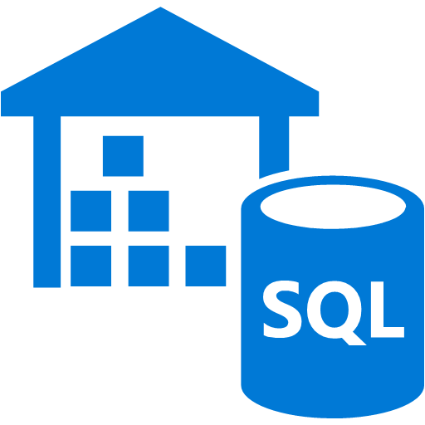
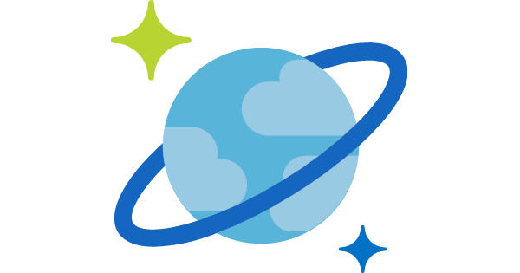

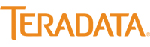
v1 Supported Services
Notes:
All supported services in v1: https://docs.microsoft.com/en-us/azure/data-factory/v1/data-factory-create-datasets
Supported Services in v2: https://docs.microsoft.com/en-us/azure/data-factory/concepts-datasets-linked-services

Slide 7
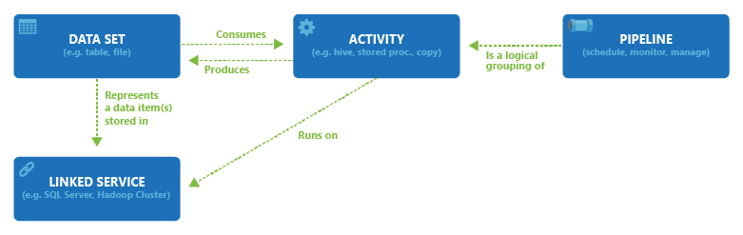
Components
Pipeline - the unit of orchestration, and container for activities
Activity - a data movement or transformation component
ie. Copy, HiveQuery, StoredProcedure, etc.
Linked Service - connection manager
i.e. Azure Blob Storage, Azure SQL DW, etc.
Data Set - a data structure within a linked service
i.e. a table or storage container, etc.

Slide 8
Components

Slide 9
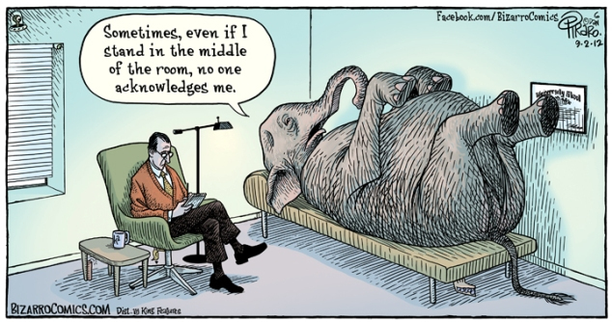

Slide 10
Why is Data Factory Different than Other Integration Tools (*cough* *cough* SSIS)
Extract, Load, then Transform
Leverage scale out compute resources to do you transforms instead of a VM running your integration service which is bound by resource limits
PaaS - pay-as-you-go
Don't need a server constantly running and accruing charges
Scheduling is time-series based and implicitly defined
Major paradigm shift; kind of complex initially
Built in task scheduler
Works with structured and unstructured data
Destinations are called "sinks"?

Slide 11
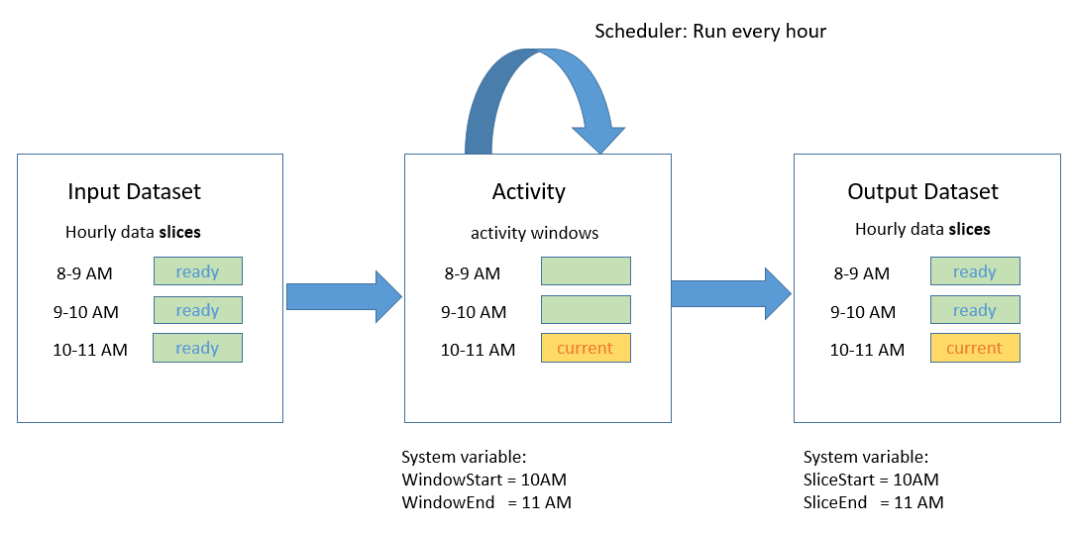
Scheduling in ADFv1
Notes:
https://docs.microsoft.com/en-us/azure/data-factory/v1/data-factory-scheduling-and-execution

Slide 12
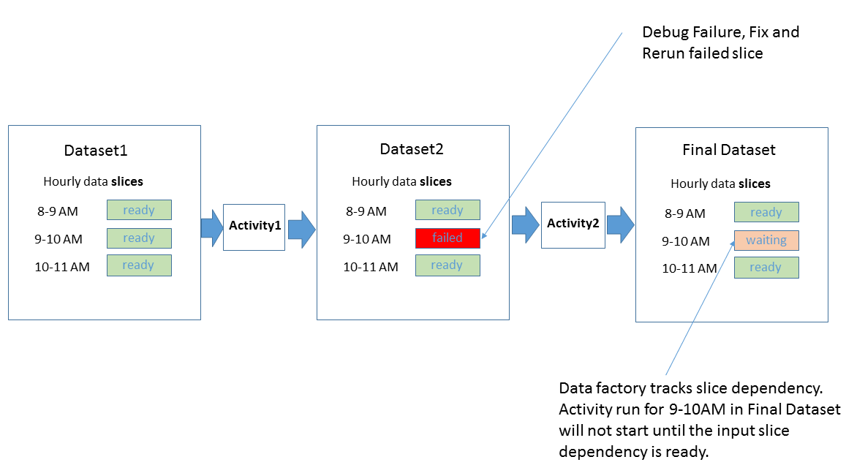
Scheduling in ADFv1

Slide 13
Developing Data Factories
Azure Portal Non-Microsoft clients Exploration | Visual Studio Mature development environments Multiple environments Team development – easier collaboration | PowerShell Monitoring and Management Quick setup and tear down

Slide 14
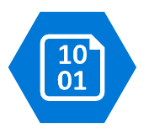
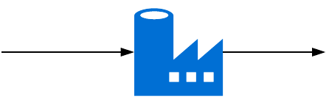
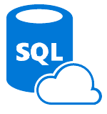
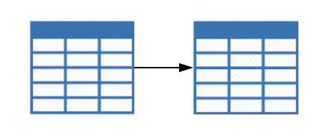
Demo Architecture
Blog Storage -
Daily Sales Files
Data Factory
Azure SQL -
Sales DataMart
Staging Table
Summary Table

Slide 15
Demo!
Tools and extensions:
Microsoft Azure Data Factory Tools for Visual Studio 2015
Cloud Explorer for Visual Studio 2015
Spin up an Azure Data Factory
Azure Storage with files and empty Azure SQL DB should be ready to go
Copy Azure Blob Storage to Azure SQL Database
Use SQL write cleanup script
Notes:
ADF Tools: https://marketplace.visualstudio.com/items?itemName=AzureDataFactory.MicrosoftAzureDataFactoryToolsforVisualStudio2015
Cloud Explorer: https://marketplace.visualstudio.com/items?itemName=MicrosoftCloudExplorer.CloudExplorerforVisualStudio2015

Slide 16
How do we Monitor our New Pipeline?
Azure Portal > Data Factory > Monitor & Manage
PowerShell

Slide 17
Use Cases
Time-series, ie. web logs, social sentiment, etc.
Hybrid integrations
Advanced Analytics workflows
Cloud migration

Slide 18
When ADF is NOT the Best Option
Required data sources are not supported
Loading Azure Data Warehouse
Polybase is more performant
Extracting from a non-time series source
Anytime before v2 is Generally Available!

Slide 19
Challenges and Best Practices
Challenges
The scheduling component can be very challenging to work with
The lack of expressions and variables within a control flow is a big gap
Best Practices
Use consistent naming conventions
Always publish pipelines with isPaused: True
Test thoroughly before promoting to production

Slide 20
Azure Data Factory v2
High-level
ADFv1 – is a service designed for the batch data processing of time series data
ADFv2 – is a general purpose, hybrid data integration service with very flexible execution patterns
New Features:
Integration Runtime (publish SSIS packages)
Branching logic (On success, On failure, On Completion, On skip)
Web Development UI
Expressions and Parameters
System Variables
Event and Scheduled Triggers
Additional Activity Types
Way more data sources! Eg. BigQuery, Dynamics 365, and way more
Notes:
https://docs.microsoft.com/en-us/azure/data-factory/compare-versions
https://www.purplefrogsystems.com/paul/2017/09/whats-new-in-azure-data-factory-version-2-adfv2/

Slide 21
Fin.

